Slide 1
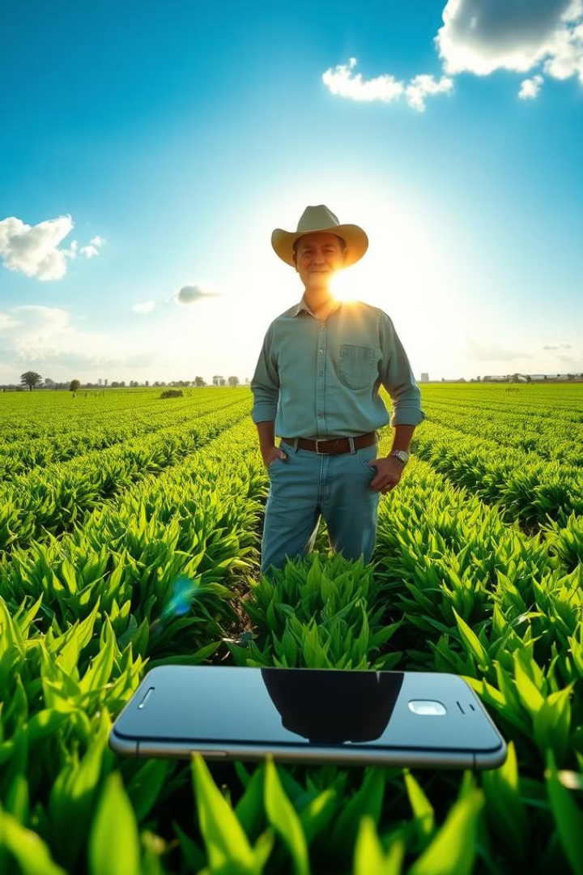

GloystarsInternational: Agricultural Solution Bank
This project is an Android application designed to revolutionize the agricultural sector.
by Wilson Kinda

Slide 2

Problem Statement
Stakeholders face challenges like fragmented markets and limited access to resources.
Fragmented Markets
Limited access to resources
Inefficient Connections
Lack of collaboration and transparency

Slide 3
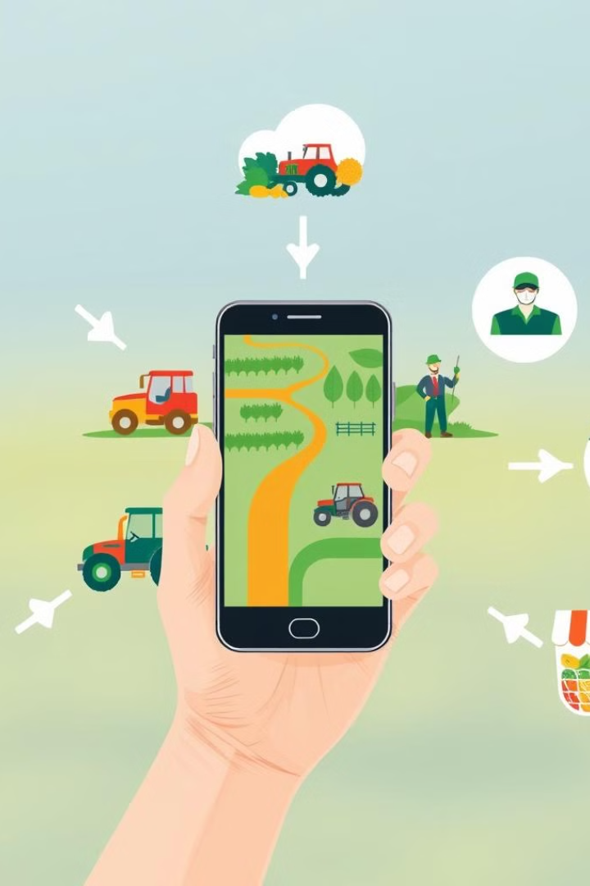
Aim of the Study
Investigate the effectiveness and usability of the GloystarsInternational app.
1
Connect Stakeholders
Landleasers, farmers, markets, and consumers
2
Promote Collaboration
Transparency and innovation in the agricultural sector
3
Drive Economic Development
Sustainability in the agricultural sector

Slide 4
Specific Objectives
Assess user satisfaction and perceived usefulness of the app.
User Satisfaction
Market Access
Socio-Economic Benefits
Evaluate the app's effectiveness in facilitating communication and collaboration.
Analyze the app's impact on improving market access and transparency for farmers and markets.
Explore the app's potential to increase productivity and income generation.

Slide 5
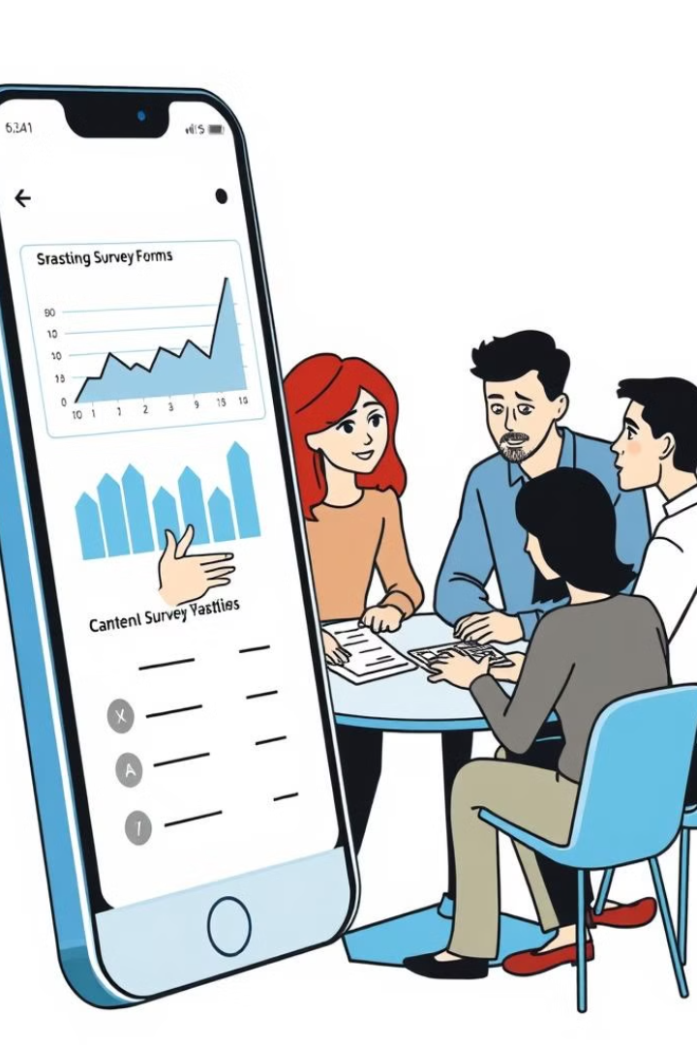
Methodology
A mixed-methods approach will be employed to evaluate the app's effectiveness, usability, and impact.
Survey Design
Gather quantitative data on user satisfaction, perceived usefulness, and app usage patterns.
Interviews and Focus Groups
Explore in-depth perspectives, experiences, and challenges related to the app's usage and impact.

Slide 6



System Development Methodology
The system development methodology follows an iterative and user-centered approach.
Requirement Gathering
Engage with stakeholders to understand their needs and preferences.
System Design
Create wireframes and prototypes to visualize the app's interface and functionality.

